Slide 1
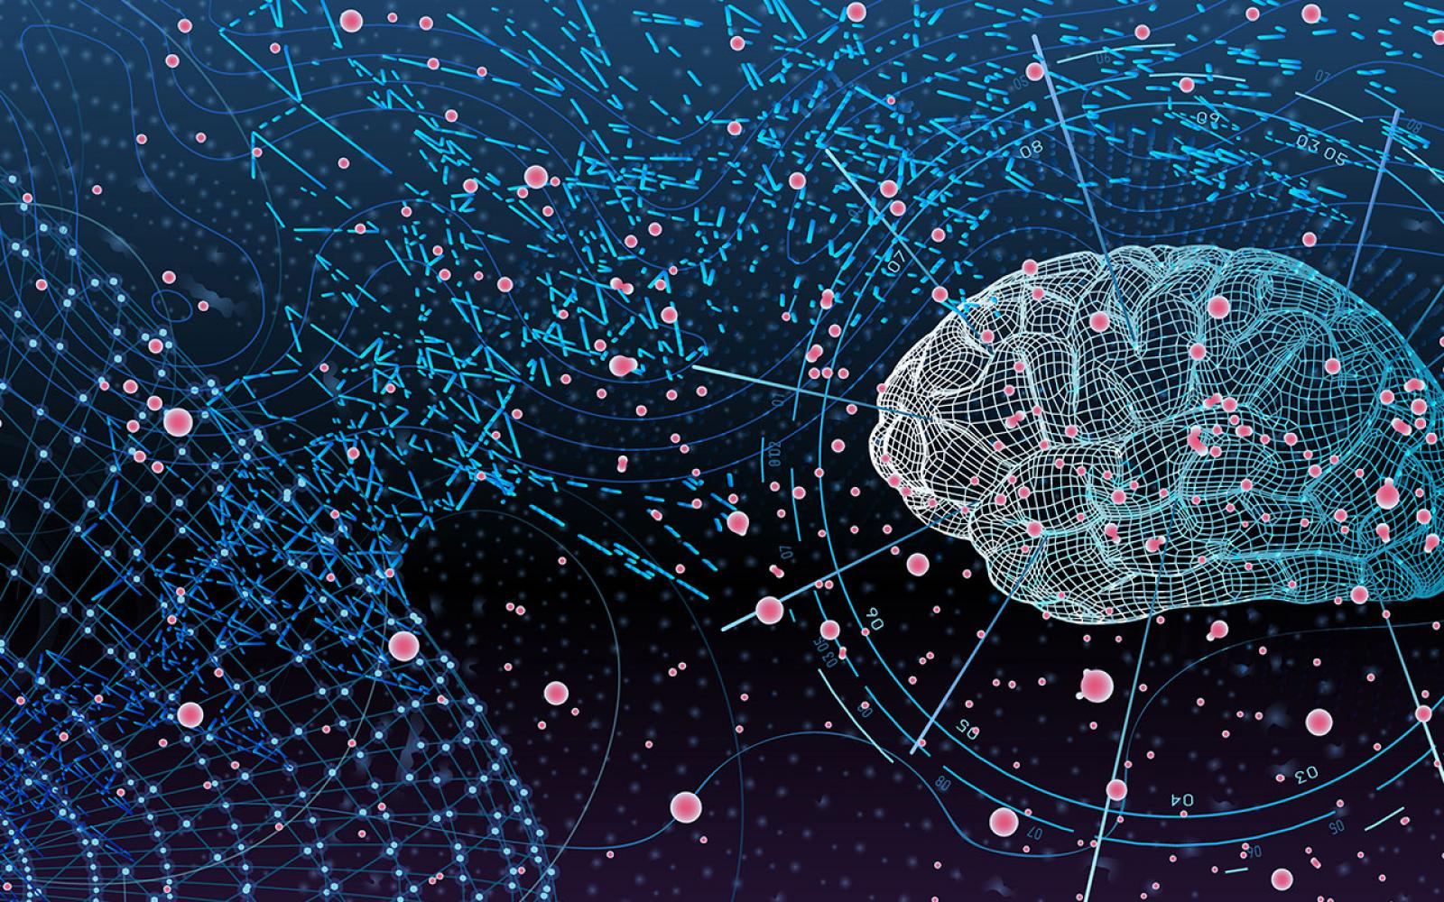
U-Net: Convolutional Networks for biomedical image segmentaion
Pattern Recognition Lab
Author:Olaf Ronneberger,Philipp Fischer and Tomas Brox

Slide 2

Presented By Group 7
Pattern Recognition Lab
Mazharul Islam Leon 011 153 031
Md Ifraham Iqbal 011 161 282
Sadaf Meem 011 153 048
Sharmin Sultana 011 153 002
Sanjana Rahman 011 161 065

Slide 3
Outline
Pattern Recognition Lab
Introduction To Neural Network
Architecture & U-Net
Image Segmentation
Conclusion
Summaries of official Papers
3

Slide 4
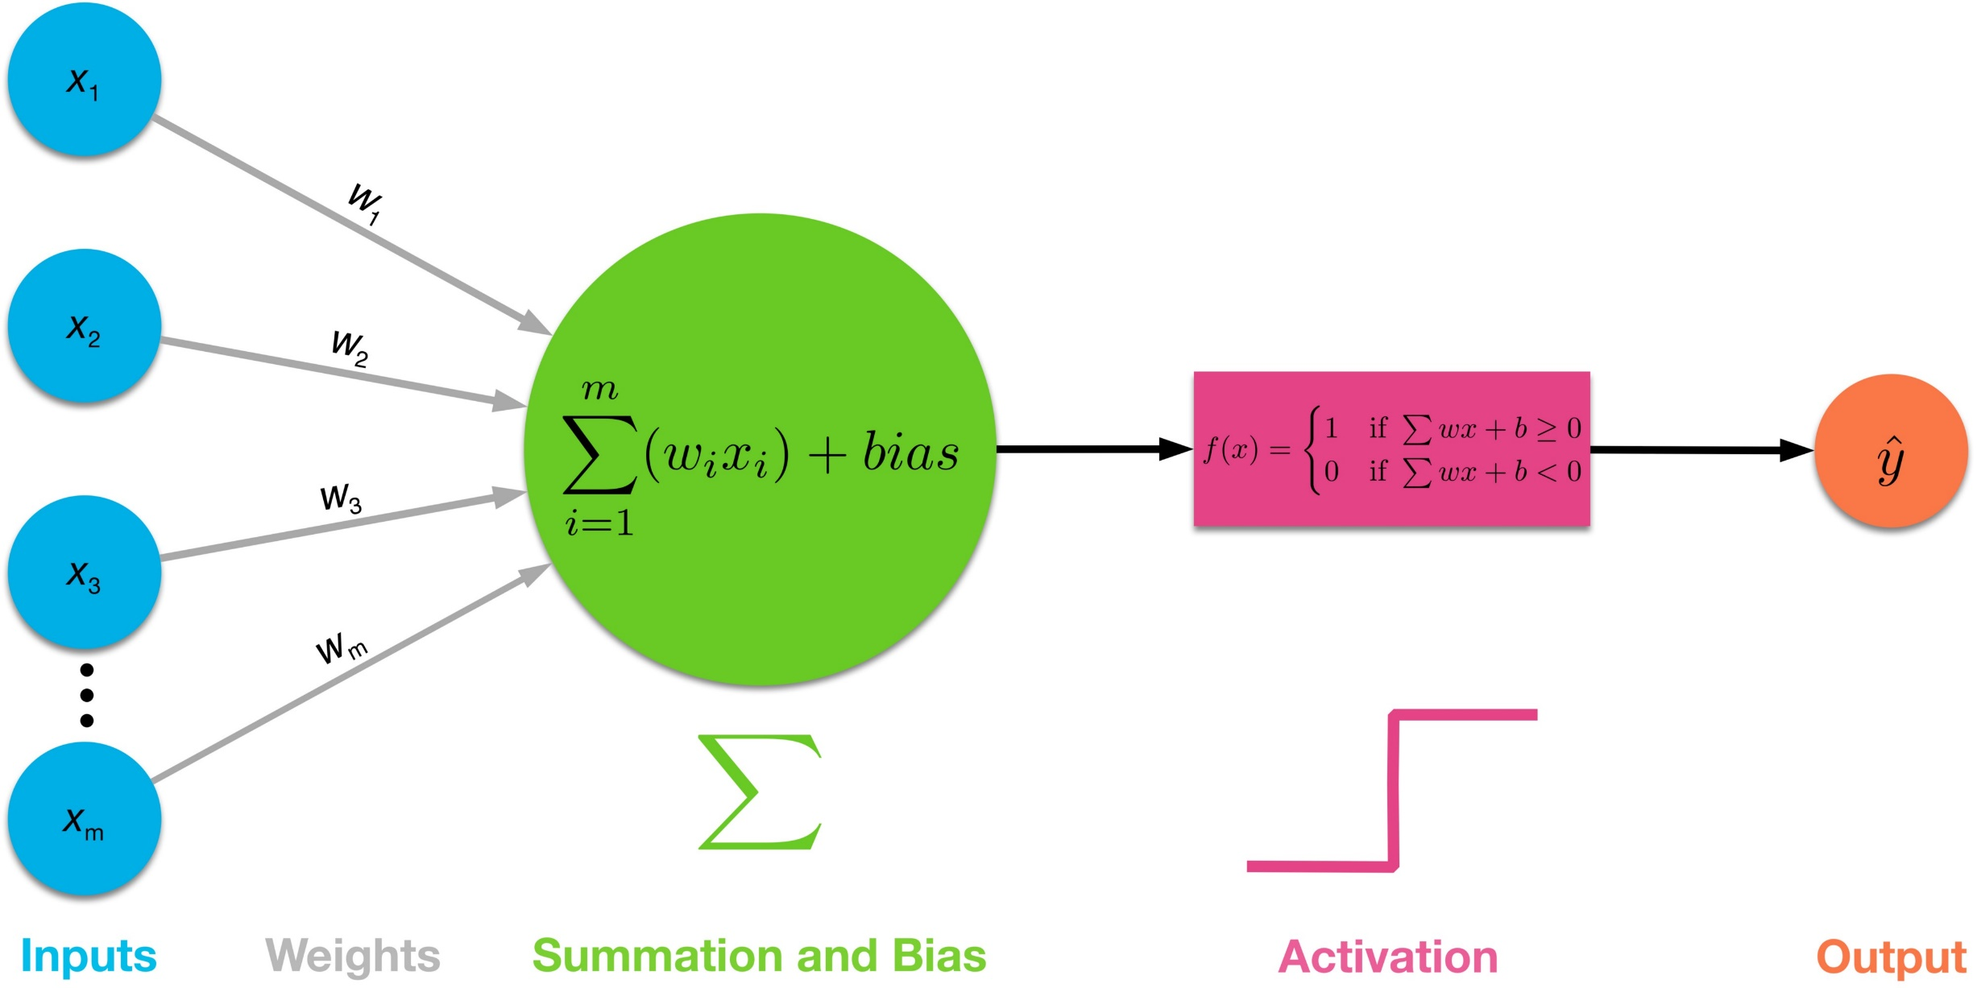
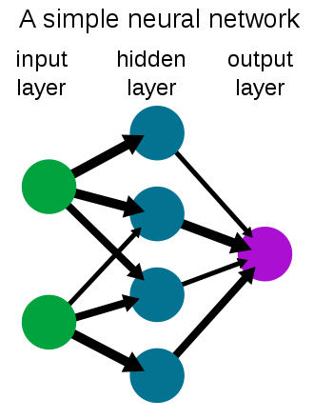
Inro to NN
Pattern Recognition Lab
Input Data
Weight & Bias
Activation Function
Optimizer
4

Slide 5
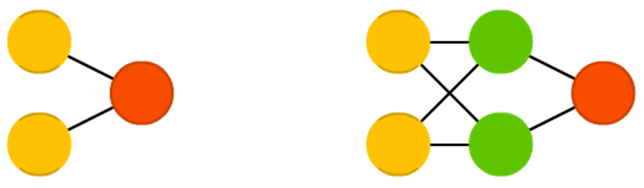
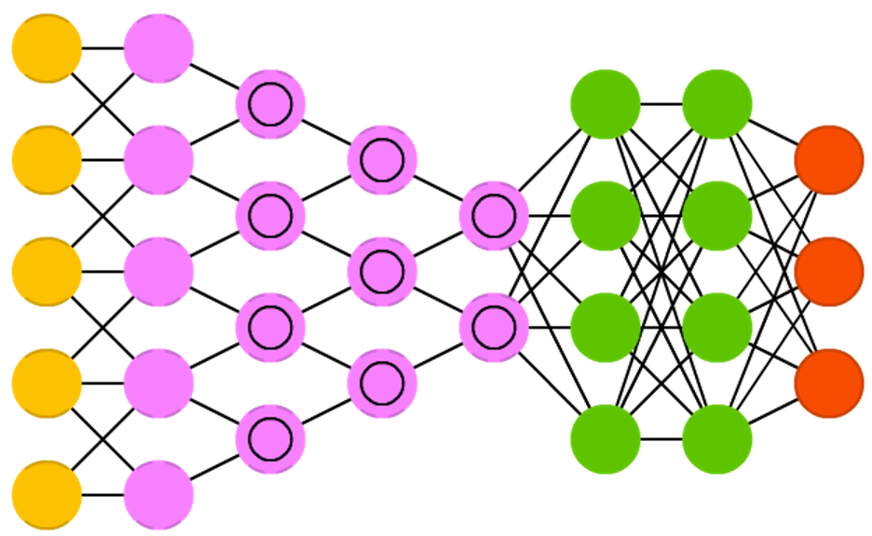
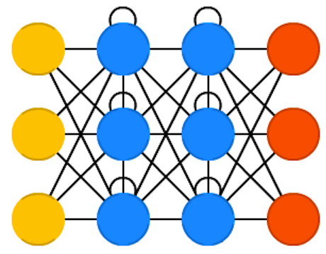
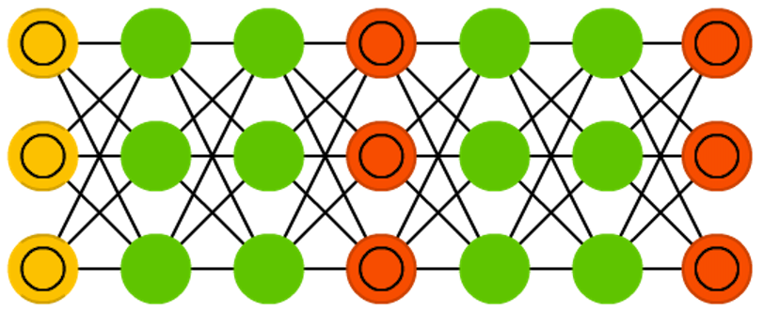
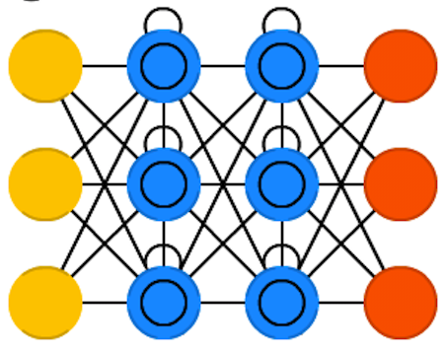
Architecture & U-Net
Pattern Recognition Lab
Single – Perceptron's & Multi Layer Perceptron's
AlexNet
Convolutional Neural Network (CNN)
VGG-16, VGG-19
GAN
Recurrent Neural Network (RNN)
LSTM
And .. Many more architecture available
Why need different type of architecture ?
Perceptrons
CNN
RNN
LSTM
GAN
5

Slide 6

Architecture & U-Net
Pattern Recognition Lab
U Shape Architecture
Conv Layer
Contraction
Expansion
6

Slide 7
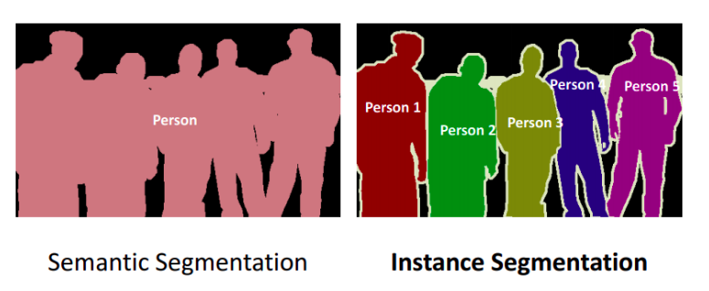
Image Segmentation
Pattern Recognition Lab
Instance Segmentation- Objection detection
Semantic Segmentation- Biomedical, cell/neocleus tracking, tumor detection etc.
U-Net Architecture use semantic segmentation
7

Slide 8
Summaries
Pattern Recognition Lab
ISBI Cell Tracking Challenge Winner -2015
The Network is Fast
Work's with 512 x 512 pixel images
Localization Output for biomedical images processing( i.e., a class label is supposed to be assigned to each pixel )
Modify and Extend FCNN
Data Augmentation : Shift, rotation, random elastic-deformation
Activation Function: ReLU
Optimizer: SGD
Dataset Provided EM segmentation challenge at ISBI 2012
8

Slide 9
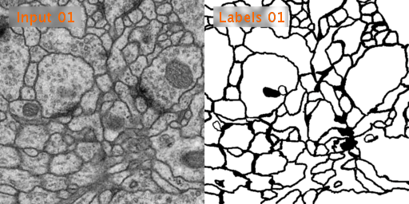
Summaries
Pattern Recognition Lab
Sample Input data and corresponding output labels
8

Slide 10
Conclusion
Pattern Recognition Lab
Very good performance on various biomedical image segmentation . Because of data augmentation with elastic-deformation.
9

Slide 11
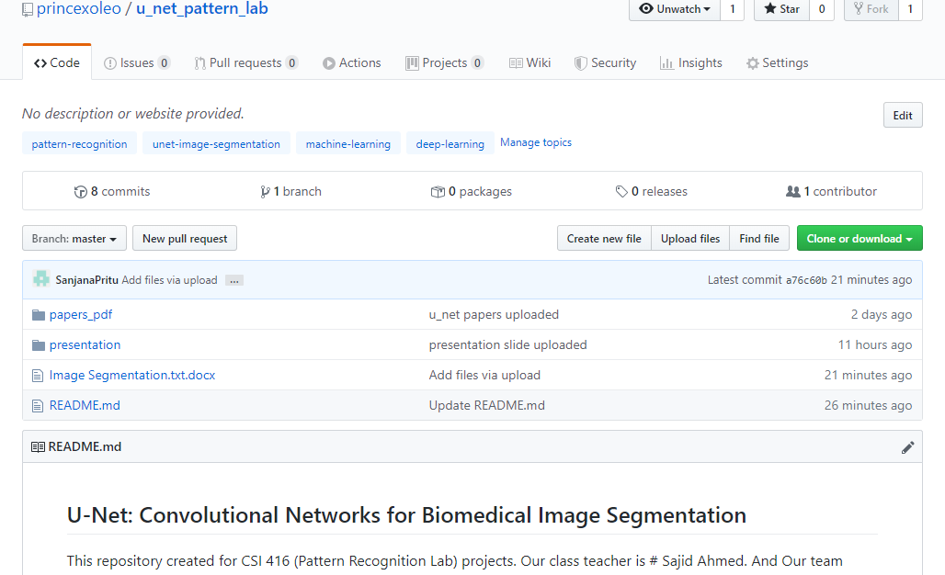
Conclusion
Pattern Recognition Lab
10

Slide 12
THANK YOU
Pattern Recognition Lab
“Don’t worry about it, if you don’t understand.”
Andrew Ng.

